Slide 1
INTERNAL and DELIBERATIVE PRELIMINARY NRCS CONSERVATION PRACTICE ATMOSHERIC BENEFITS, CO-BENEFITS AND ANCILLARY BENEFITS
Developed by Adam Chambers
Adam.chambers@usda.gov
503-320-9114
- - - NOT FOR DISTRIBUTION OR SHARING - - -

Slide 2
Conservation Practices Analyzed

Slide 3
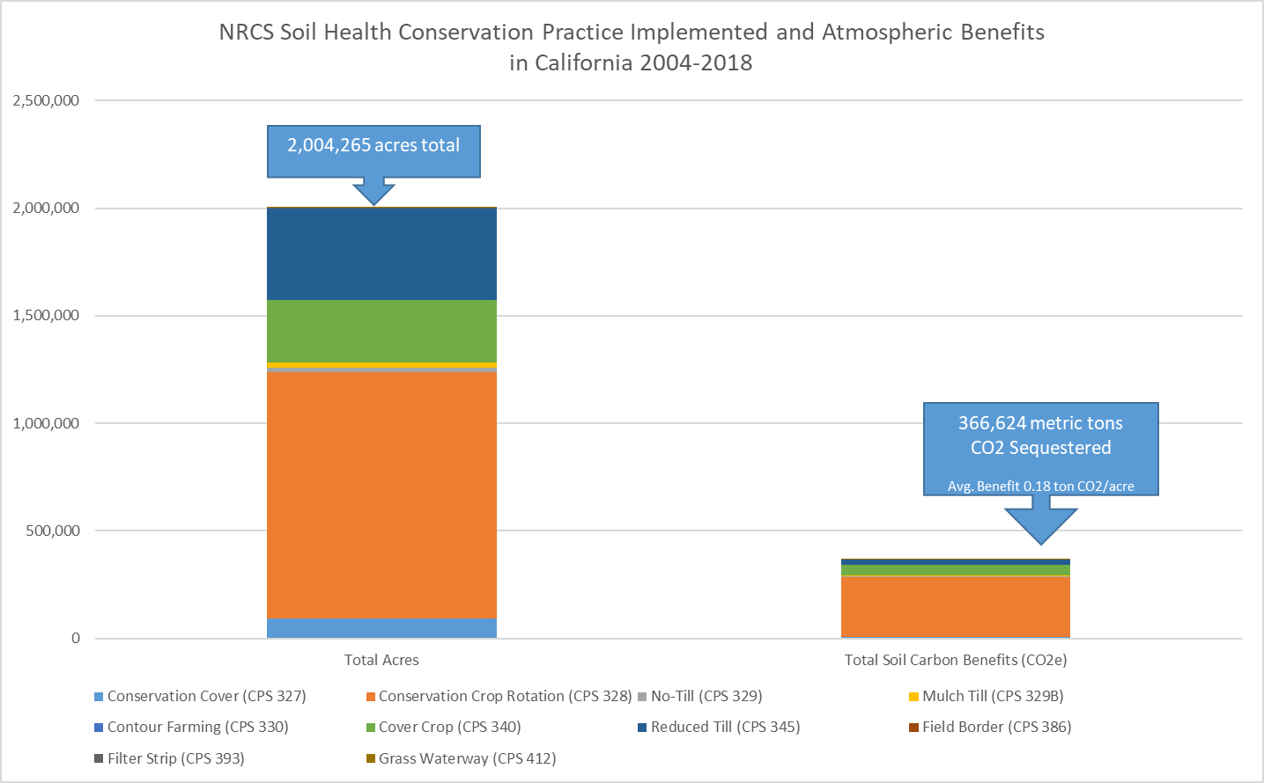

Slide 4
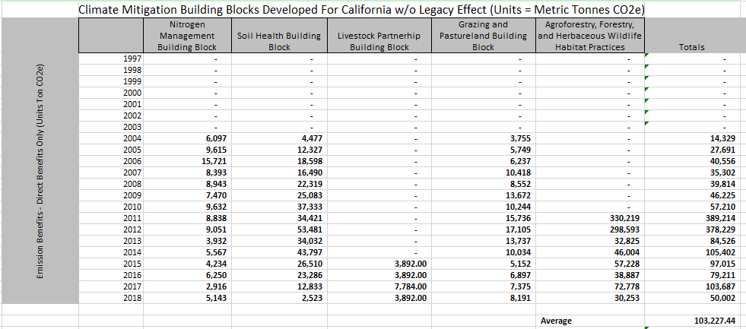
Direct Atmospheric Benefits – Climate Change w/o CLE

Slide 5
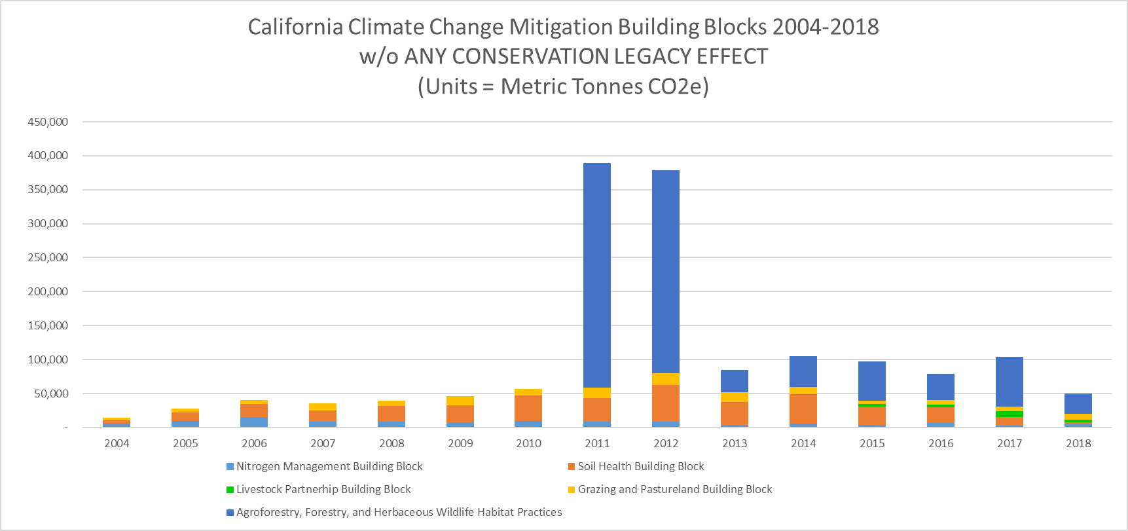
Direct Atmospheric Benefits – Climate Change

Slide 6
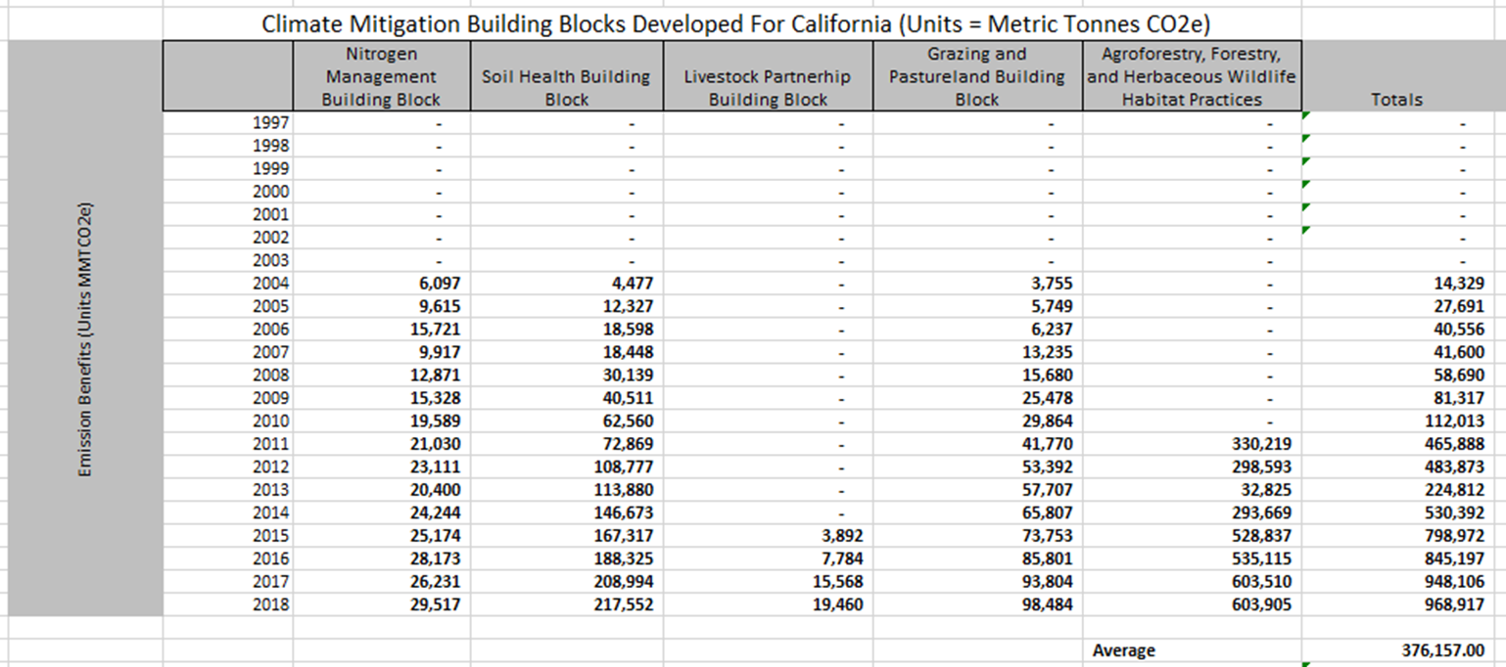
Atmospheric Benefits (+CLE - compounded) – Climate Change

Slide 7
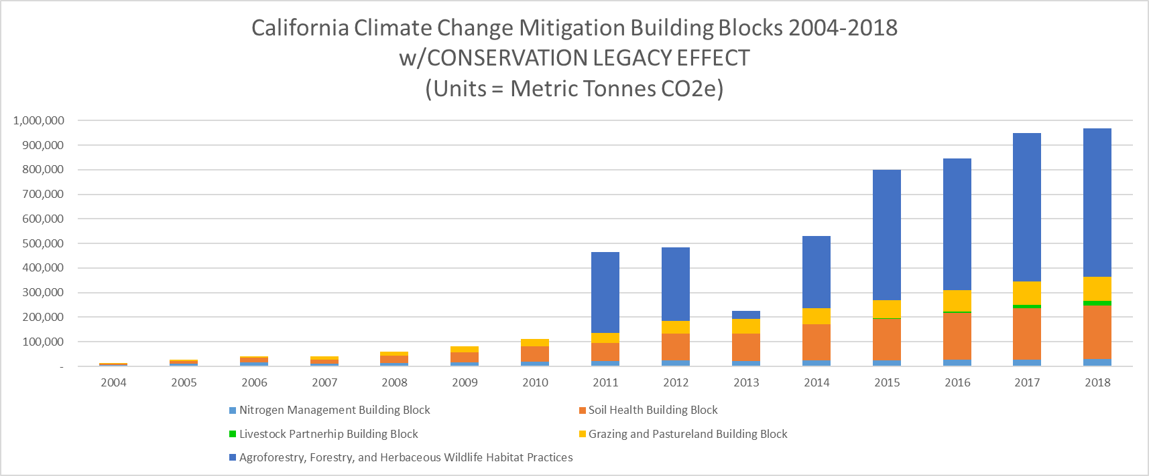
Atmospheric Benefits (+CLE - compounded) – Climate Change

Slide 8
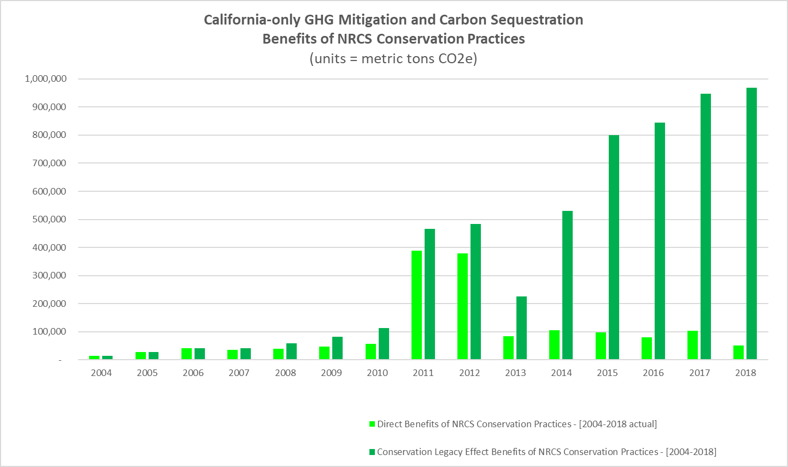
Comparing Compounded Benefits and Direct Annual Benefits
For Reference: State of CA 2017 Emissions were 424,000,000 tons
And CA Ag. Sector was 30,700,000*
NRCS Practices REDUCE EMISSIONS
~0.1-0.3 percent of total footprint
and
~1.0-4.6 percent of ag footprint
*See https://ww3.arb.ca.gov/cc/inventory/data/tables/ghg_inventory_ipcc_sum_2000-17.pdf

Slide 9
Takeaway Results – NRCS Climate-Smart Solutions
NRCS Voluntary Conservation Practices are Providing Atmospheric Benefits in California
Direct Benefits from Carbon Farm Planning and Other Efforts
Co-Benefits for Implementing Conservation Practices
Ancillary Benefits when Conservation Practices are Installed for Other Purposes
NRCS can quantify these benefits and partners may find this interesting
NRCS also provides technical support and leadership in this area – State of California government leverages this technical assistance
Discussion Question: Sharing these results with Partners and State of California staff might be beneficial, do you have any thoughts?

Slide 10
<END>
Preliminary and Deliberative Results
- - NOT FOR DISTRIBUTION OR SHARING - - -
Thank You
Dr. Adam Chambers
Adam.chambers@usda.gov
503-320-9114

